Slide 1
Describing Motion

Slide 2
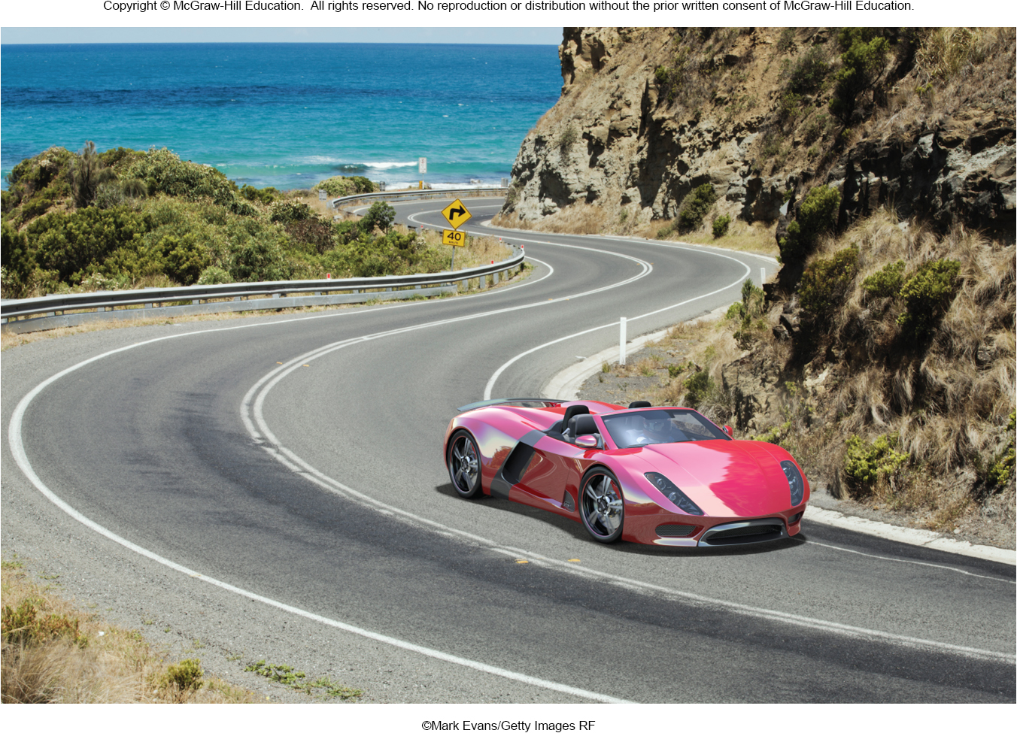
Why do we need clear, precise definitions?
What’s the difference between:
average speed and instantaneous speed?
speed and velocity?
speed and acceleration?
Notes:
Fig. 2.co

Slide 3
Speed
Speed is how fast an changes its location.
Speed is always some distance divided by some time.
The units of speed may be miles per hour, or meters per second, or kilometers per hour, or inches per minute, etc.
Average speed is total distance divided by total time.

Slide 4
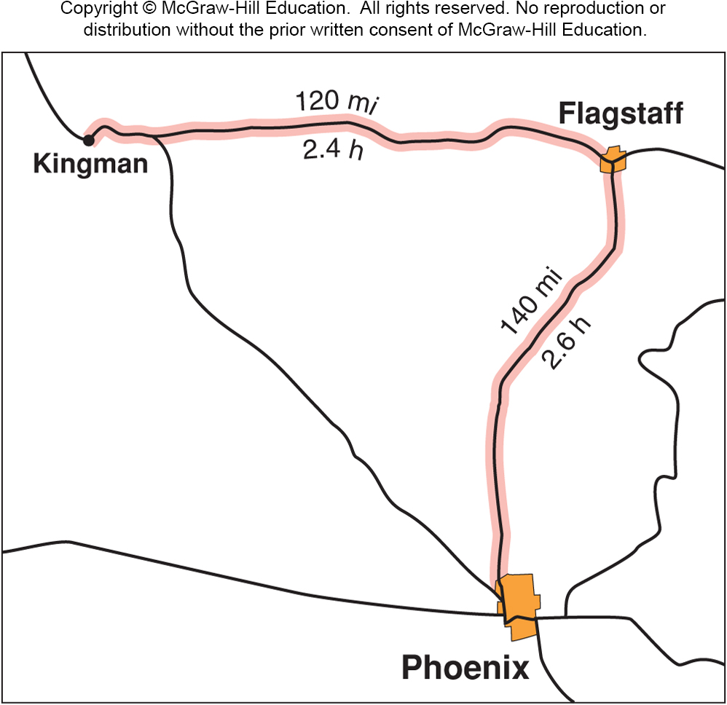
Average Speed
Kingman to Flagstaff:
120 mi ÷ 2.4 hr
= 50.0 mph
Flagstaff to Phoenix:
140 mi ÷ 2.6 hr
= 53.8 mph
Total trip:
120 mi + 140 mi
= 260 mi
2.4 hr + 2.6 hr
= 5.0 hr
260 mi ÷ 5.0 hr
= 52.0 mph
Notes:
Fig. 2.02

Slide 5
Speed (cont.)
Rate is one quantity divided by another quantity.
For example: gallons per minute, pesos per dollar, points per game.
So average speed is the rate at which distance is covered over time.
Instantaneous speed is the speed at that precise instant in time.
It is the rate at which distance is being covered at a given instant in time.
It is found by calculating the average speed, over a short enough time that the speed does not change much.

Slide 6
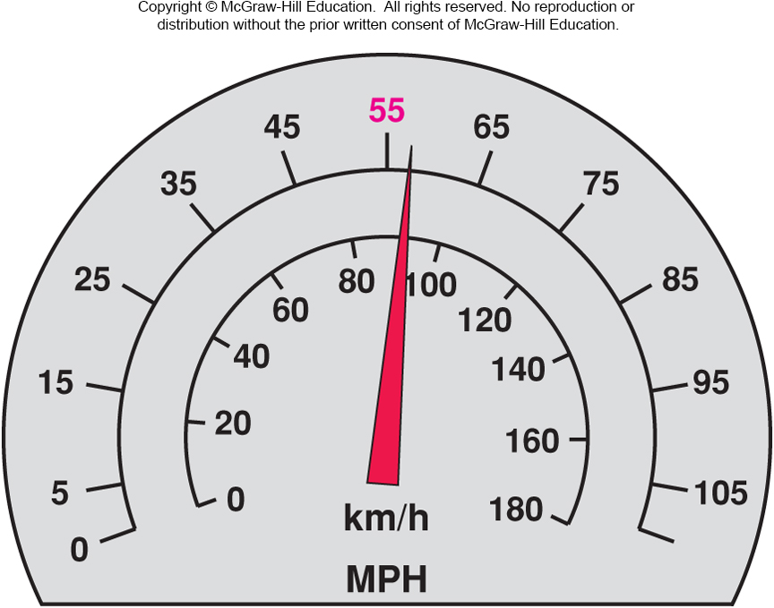
Instantaneous Speed
The speedometer tells us how fast we are going at a given instant in time.
Notes:
Fig. 2.03

Slide 7
Velocity
Velocity involves direction of motion as well as how fast the object is going.
Velocity is a vector quantity.
Vectors have both magnitude and direction.
Velocity has a magnitude (the speed) and also a direction (which way the object is moving).
A change in velocity can be a change in the object’s speed or direction of motion.
A speedometer doesn’t indicate direction, so it indicates instantaneous speed but not velocity.

Slide 8
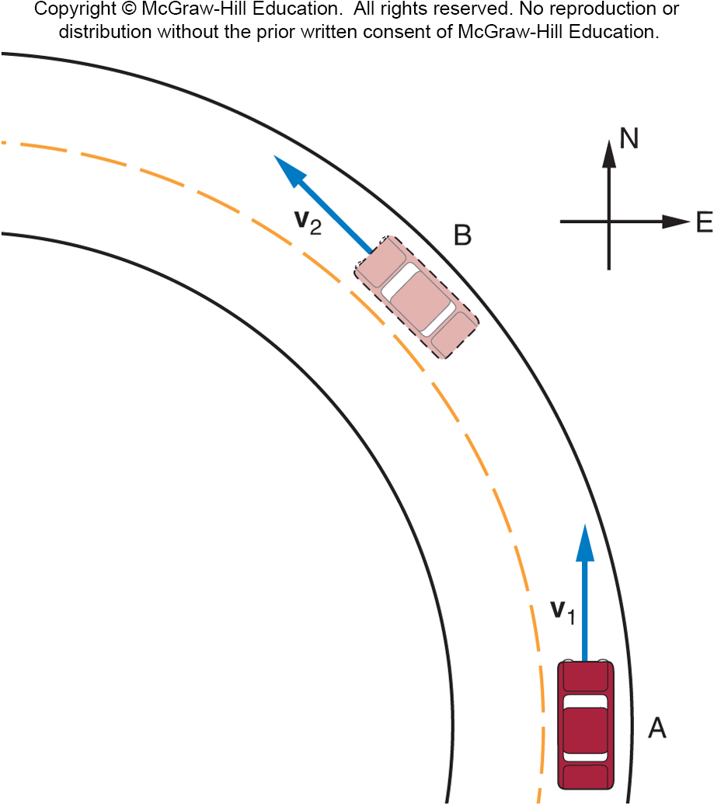
A car goes around a curve at constant speed. Is the car’s velocity changing?
Yes
No
At position A, the car has the velocity indicated by the arrow (vector) v₁.
At position B, the car has the velocity indicated by the arrow (vector) v₂, with the same magnitude (speed) but a different direction.

Slide 9
Acceleration
Acceleration is the rate at which velocity changes.
Our bodies don’t feel velocity, if the velocity is constant.
Our bodies feel acceleration.
A car changing speed or direction.
An elevator speeding up or slowing down.
Acceleration can be either a change in the object’s speed or direction of motion.

Slide 10
Acceleration (cont.)
Acceleration is also a vector quantity, with magnitude and direction.
The direction of the acceleration vector is that of the change in velocity, ∆v.
Acceleration refers to any change in velocity.
We even refer to a decrease in velocity (a slowing down) as an acceleration.

Slide 11
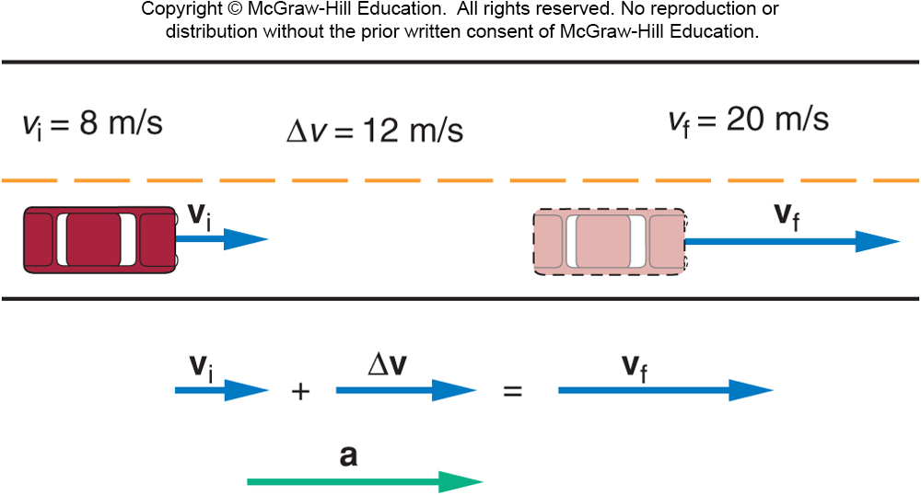
Acceleration (cont.)
The direction of the acceleration vector is that of the change in velocity, ∆v.
If velocity is increasing, the acceleration is in the same direction as the velocity.

Slide 12
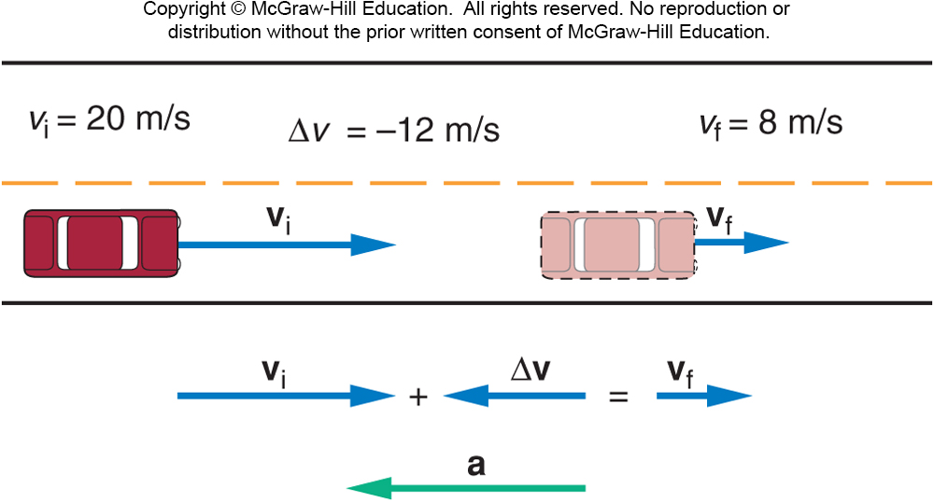
Acceleration (cont.)
The direction of the acceleration vector is that of the change in velocity, ∆v.
If velocity is decreasing, the acceleration is in the opposite direction as the velocity.

Slide 13
Average Acceleration
Average acceleration is the change in velocity divided by the time required to produce that change.
The units of velocity are units of distance divided by units of time.
The units of acceleration are units of velocity divided by units of time.
So, the units of acceleration are units of (distance divided by time) divided by units of time:

Slide 14
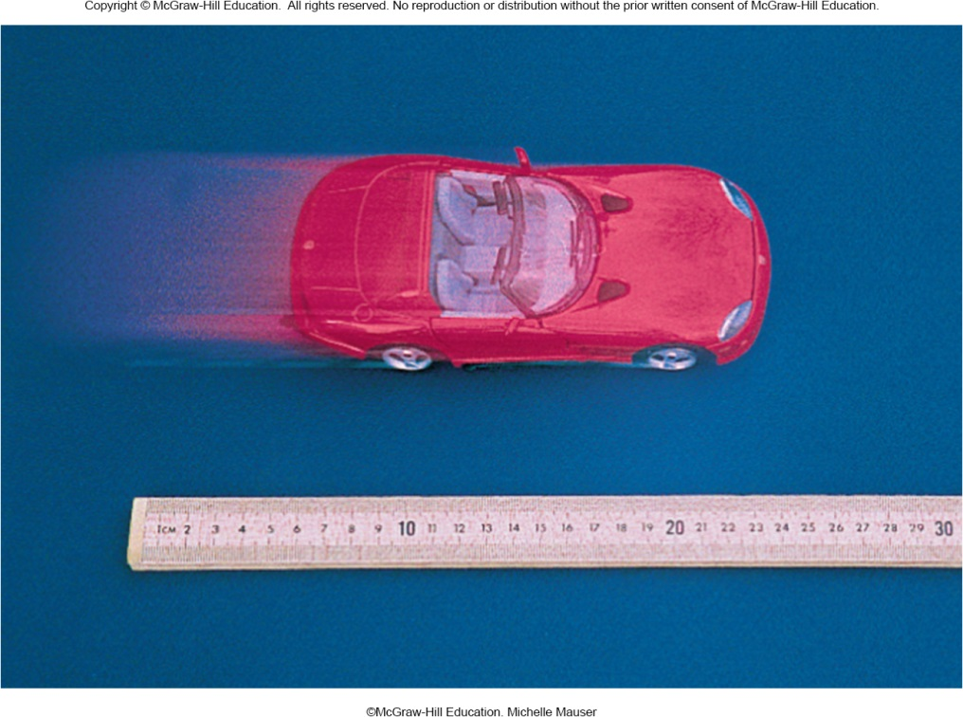
Graphing Motion
To describe the car’s motion, we could note the car’s position every 5 seconds.
Time | Position
0 s | 0.0 cm
5 s | 4.1 cm
10 s | 7.9 cm
15 s | 12.1 cm
20 s | 16.0 cm
25 s | 16.0 cm
30 s | 16.0 cm
35 s | 18.0 cm

Slide 15
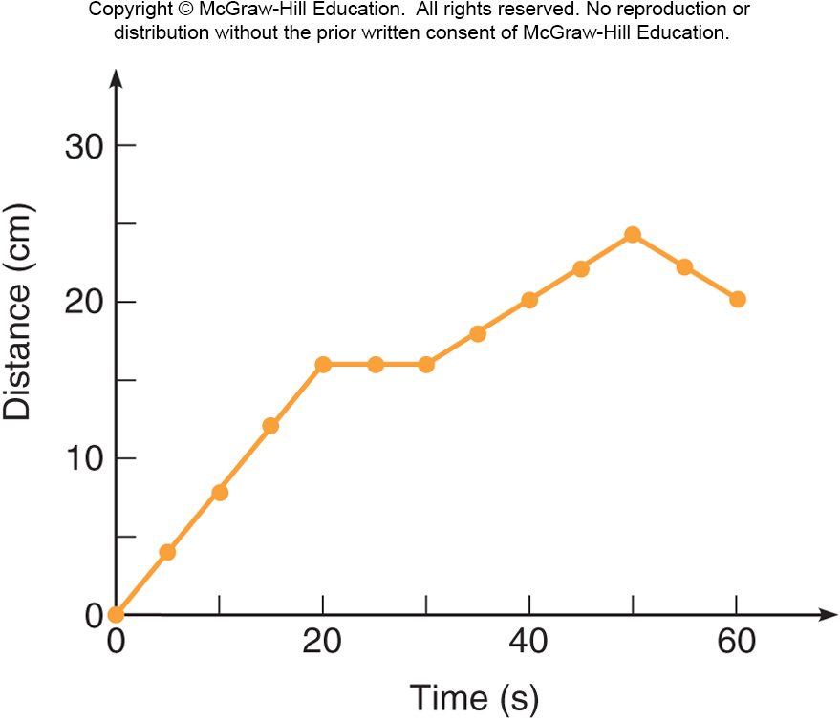
To graph the data in the table, let the horizontal axis represent time, and the vertical axis represent distance.
Each interval on an axis represents a fixed quantity of distance or time.
The first data point is at 0 seconds and 0 cm.
The second data point is at 5 seconds and 4.1 cm.
Etc.
Notes:
Fig. 2.14

Slide 16
The graph displays information in a more useful manner than a simple table.
When is the car moving the fastest?
When is it moving the slowest?
When is the car not moving at all?
At what time does the car start moving in the opposite direction?
Notes:
Fig. 2.14

Slide 17
The slope at any point on the distance-versus-time graph represents the instantaneous velocity at that time.
Slope is change in vertical quantity divided by change in horizontal quantity.
“rise over run”
Similar to everyday meaning:
steepest “slope” is between 0 s and 20 s.
slope is zero (flat) between 20 s and 30 s
slope is negative between 50 s and 60 s
Notes:
Fig. 2.14

Slide 18
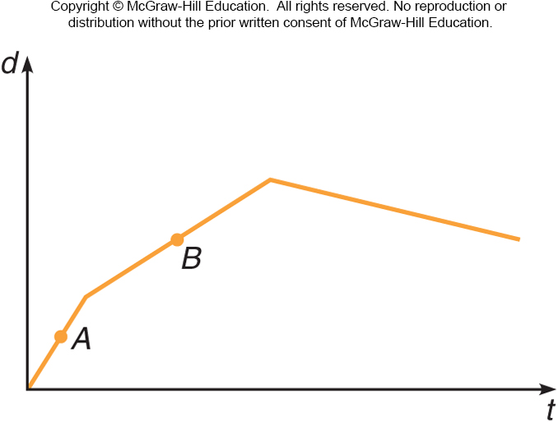
Is the instantaneous velocity at point A greater or less than that at point B?
Greater than
Less than
The same as
Unable to tell from this graph
The instantaneous velocities can be compared by looking at their slopes. The steeper slope indicates the greater instantaneous velocity, so the velocity at A is greater.

Slide 19
Falling Objects and Projectile Motion

Slide 20
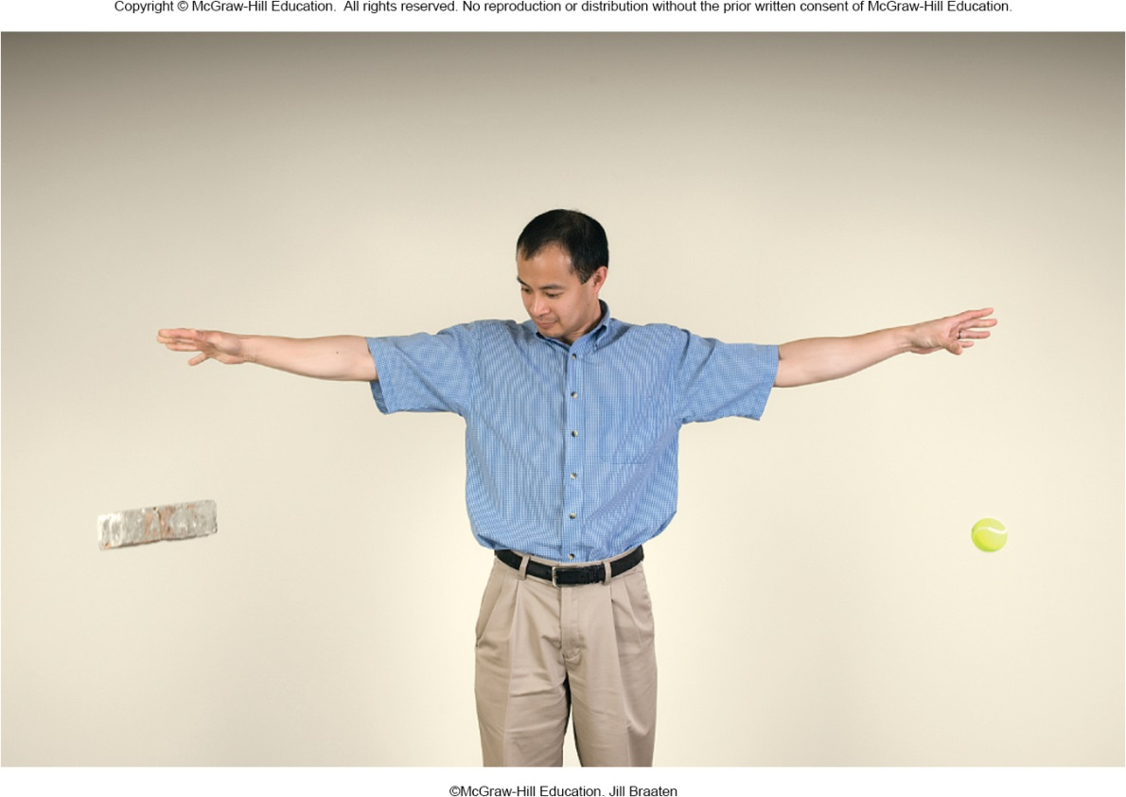
How does a dropped object behave?
Does the object accelerate, or is the speed constant?
Do two objects behave differently if they have:
different masses?
different shapes?

Slide 21
Acceleration Due to Gravity
Earth exerts a gravitational force on objects that is attractive (towards Earth’s surface).
Near Earth’s surface, this force produces a constant acceleration downward.
To measure this acceleration, we need to slow down the action.
Galileo was the first to accurately measure this acceleration due to gravity.
By rolling objects down an inclined plane, he slowed the motion enough to establish that the gravitational acceleration is uniform, or constant with time.

Slide 22
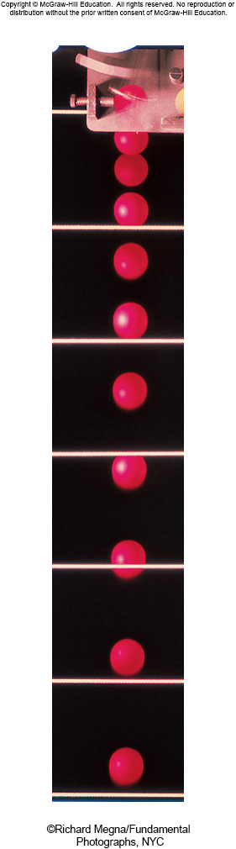
Flashes of a stroboscope illuminate a falling ball at equal time intervals.
Distance covered in successive time intervals increases regularly.
Since distance covered in equal time intervals is increasing, the velocity must be increasing.

Slide 23
Average velocity for a time interval is given by dividing the distance traveled in that time interval by the time of the interval.
For example, between the 2nd and 3rd flashes, the ball travels a distance of
4.8 cm - 1.2 cm = 3.6 cm
in a time of 0.05 s:

Slide 24
The velocity values steadily increase.
Time | Position | Average velocity
0 s | 0 cm
0.05 s | 1.2 cm | 24 cm/s
0.10 s | 4.8 cm | 72 cm/s
0.15 s | 11.0 cm | 124 cm/s
0.20 s | 19.7 cm | 174 cm/s
0.25 s | 30.6 cm | 218 cm/s
0.30 s | 44.0 cm | 268 cm/s
0.35 s | 60.0 cm | 320 cm/s

Slide 25
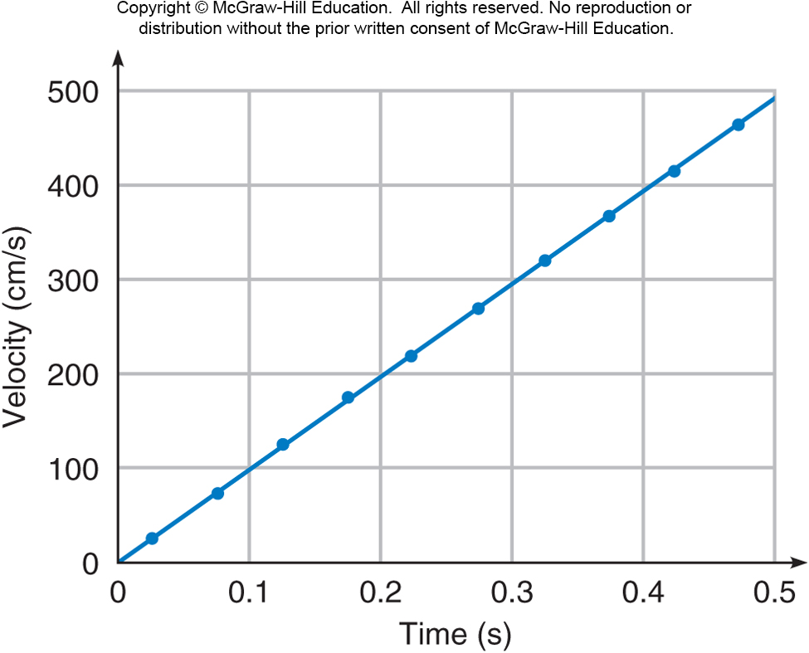
The velocity values steadily increase.
Each point is plotted at the midpoint between the two times.

Slide 26
The slope of the line is constant.
Thus, the acceleration is constant.

Slide 28
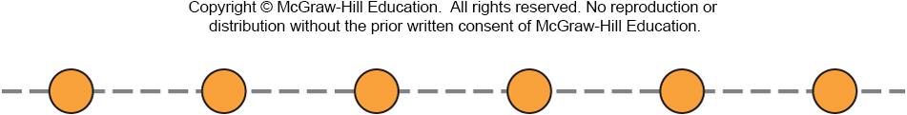
The diagram shows the positions at 0.10-sec intervals of a ball moving left to right. Is the ball accelerated?
Yes.
No.
Unable to determine.
The ball moves an equal distance during each 0.10-sec interval, so the speed does not change. Since the ball moves in a straight line at a constant speed, it is not accelerated.

Slide 29
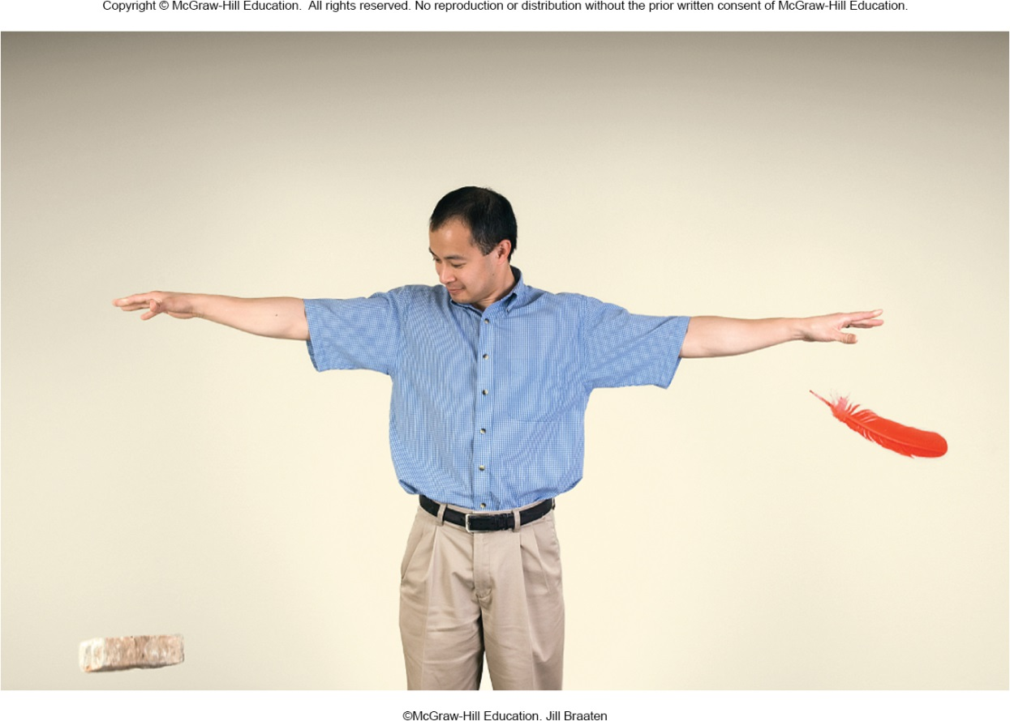
How does a dropped object behave?
Do two objects behave differently if they have:
different masses?
different shapes?
The feather falls more slowly than the brick.
But what is the REAL reason?
Air resistance!

Slide 30

How does a dropped object behave?

Slide 31
Throwing a ball downward
Let the ball be thrown downward instead of being dropped.
It will have a starting velocity different from zero.
It will reach the ground more rapidly.
It will have a larger velocity when it reaches the ground.

Slide 32
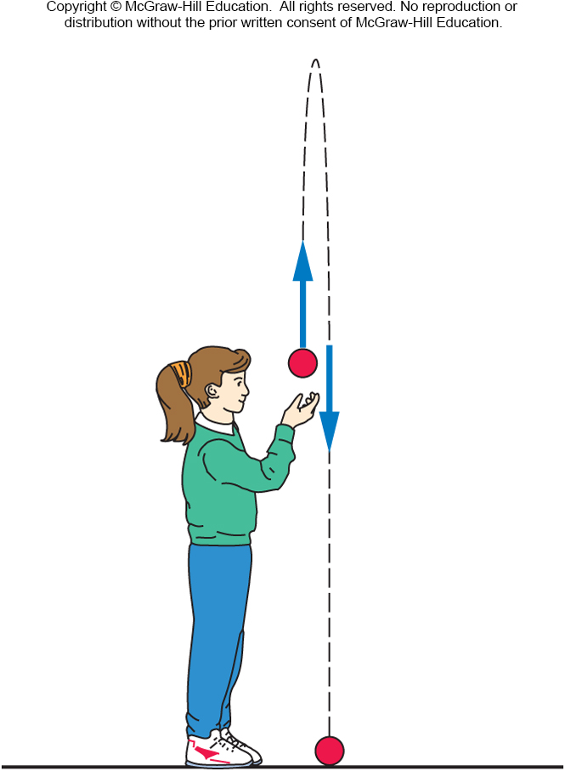
Beyond Free Fall: Throwing a Ball Upward
What if a ball is thrown upward?
Gravitational acceleration is always directed downward, toward the center of the Earth.
Here, the acceleration is in the opposite direction to the original upward velocity.

Slide 33
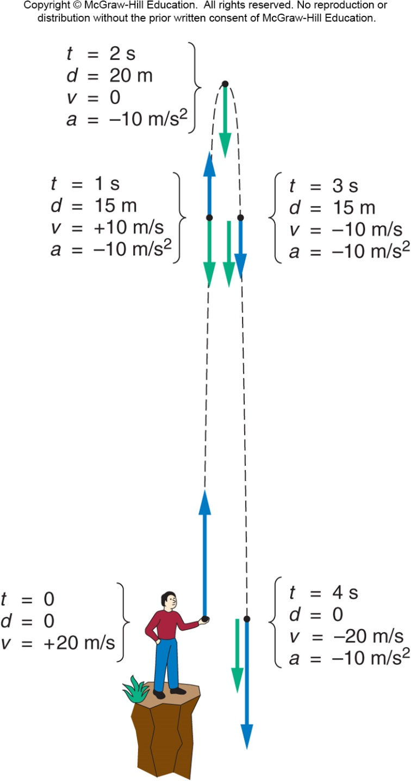
Let the initial velocity be 20 m/s upward.
It immediately starts experiencing a downward acceleration due to gravity, of approximately 10 m/s.
Every second, the velocity decreases by 10 m/s.
After 2 s, the ball has reached its highest point.
Its velocity changes direction, from upward to downward, passing through a value of 0 m/s.
Now, the downward acceleration increases the downward velocity.

Slide 34
Projectile Motion
The path that a moving object follows is called its trajectory.
An object thrown horizontally is accelerated downward under the influence of gravity.
Gravitational acceleration is only vertical, not horizontal.
The object’s horizontal velocity is unchanged, if we can neglect air resistance.
Projectile motion involves the trajectories and velocities of objects that have been launched, shot, or thrown.

Slide 35
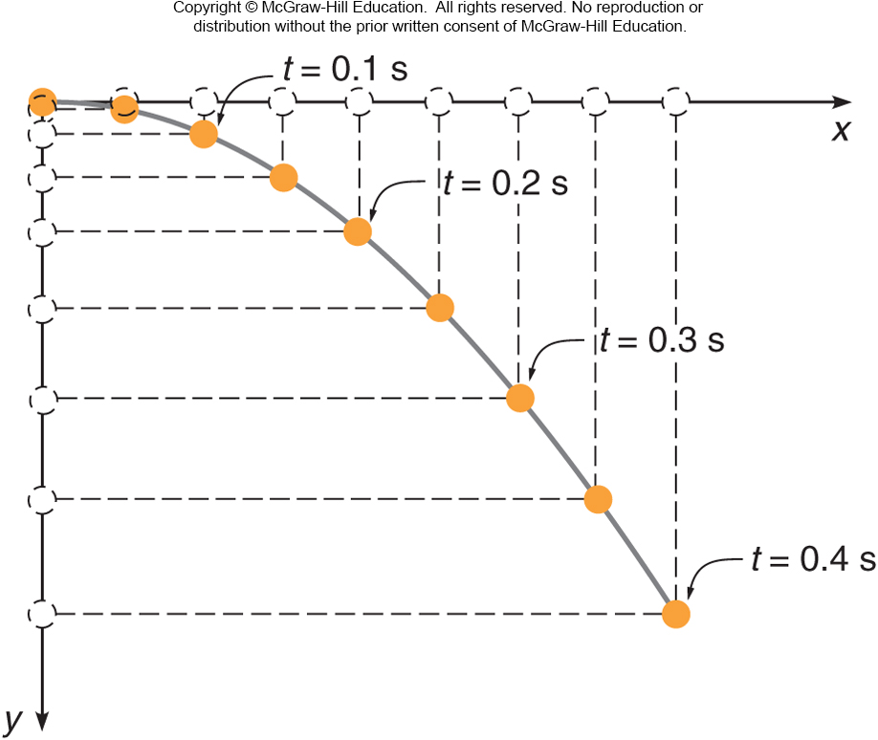
What does the trajectory look like?
The acceleration of the horizontal motion is zero (in the absence of air resistance).
The object moves with
constant horizontal velocity.
It travels equal horizontal
distances in equal time
intervals.
The acceleration in the
vertical direction is constant.
Its vertical velocity increases
downward just like the falling
ball.
In each successive time
interval, it falls a greater
distance than in the previous
time interval.

Slide 36
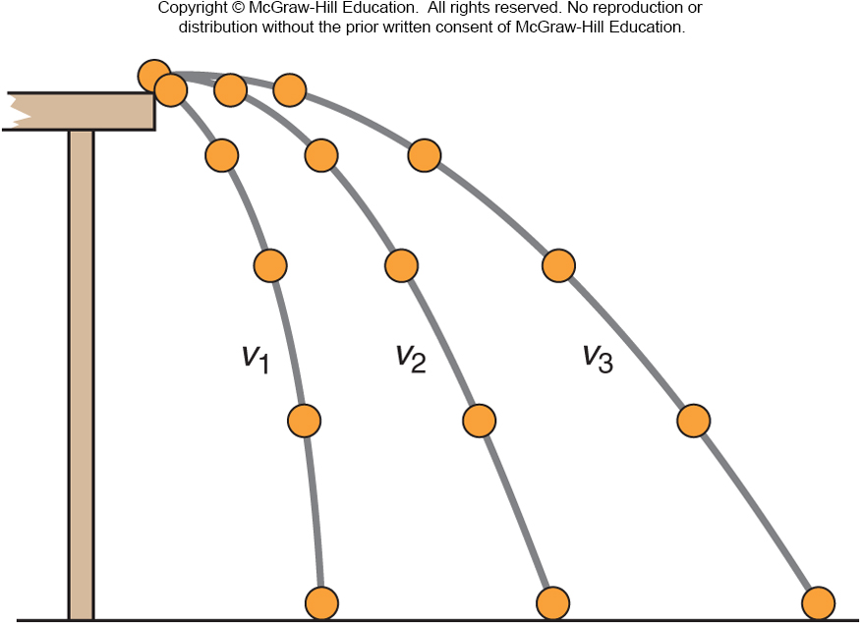
Which of these three balls would hit the floor first if all three left the tabletop at the same time?
The ball with initial velocity v₁.
The ball with initial velocity v₂.
The ball with initial velocity v₃.
They would all hit at the same time.
Since all three balls undergo the same downward acceleration, and they all start with a vertical velocity of zero, they would all fall the same distance in the same time!

Slide 37
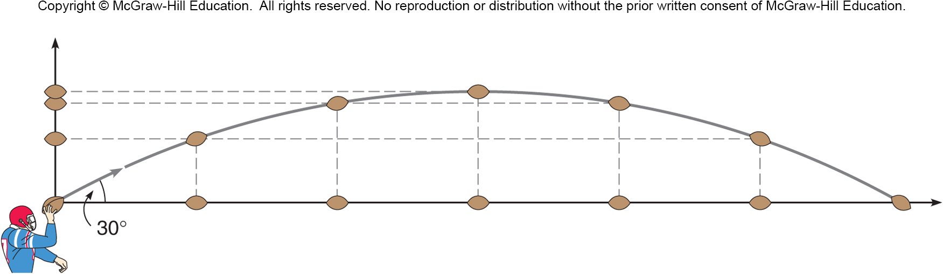
Hitting a Target
The trajectory depends on the initial velocity.
The trajectory depends on the launch angle.

Slide 38
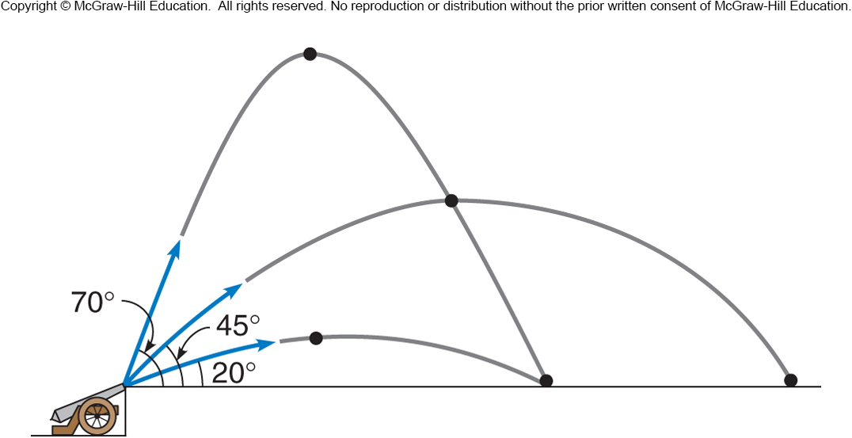
Hitting a Target
The greatest distance is achieved using an angle close to 45° if the effects of air resistance are negligible.

Slide 39
Newton’s Laws: Explaining Motion
Lecture PowerPoint

Slide 40
Sir Isaac Newton

Slide 41
A Brief History
Where do our ideas and theories about motion come from?
What roles were played by Aristotle, Galileo, and Newton?

Slide 42
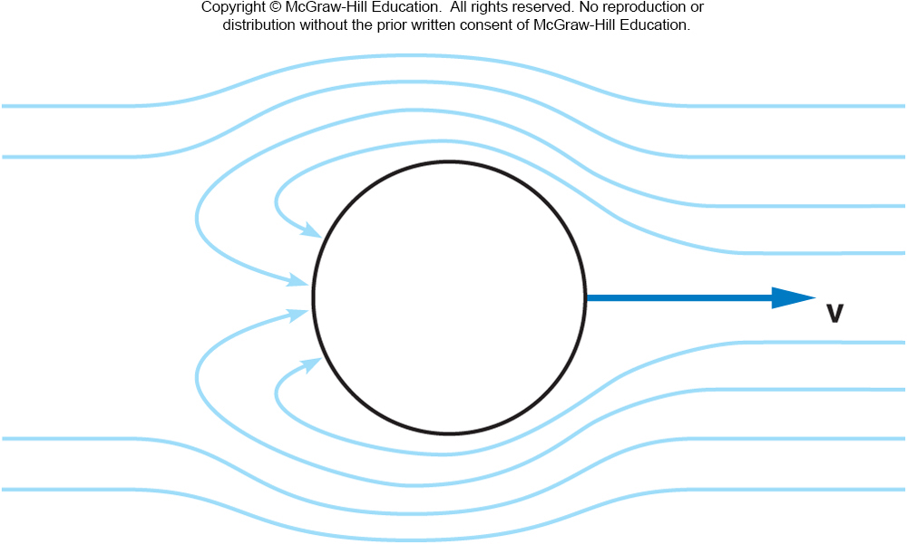
Aristotle’s View
A force is needed to keep an object moving.
Air rushing around a thrown object continues to push the object forward.

Slide 43
Galileo’s Contribution
Galileo challenged Aristotle’s ideas that had been widely accepted for many centuries.
He argued that the natural tendency of a moving object is to continue moving.
No force is needed to keep an object moving.
This goes against what we seem to experience.

Slide 44
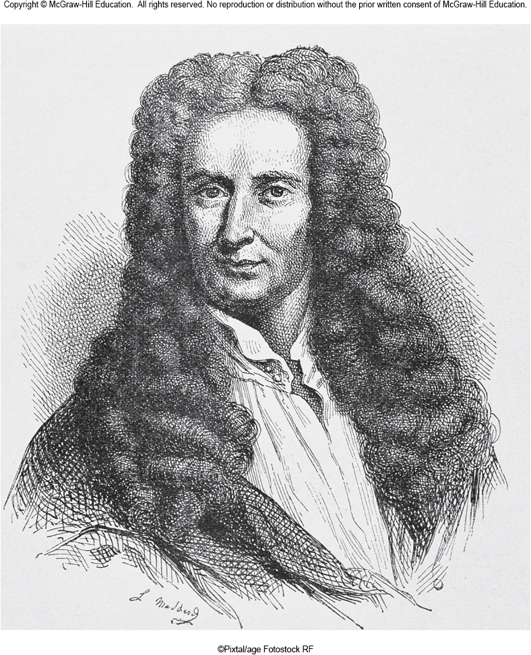
Newton’s Contribution
Newton built on Galileo’s work, expanding it.
He developed a comprehensive theory of motion that replaced Aristotle’s ideas.
Newton’s theory is still widely used to explain ordinary motions.

Slide 45
Newton’s First and Second Laws
How do forces affect the motion of an object?
What exactly do we mean by force? Is there a difference between, say, force, energy, momentum, impulse?
What do Newton’s first and second laws of motion tell us, and how are they related to one another?

Slide 46
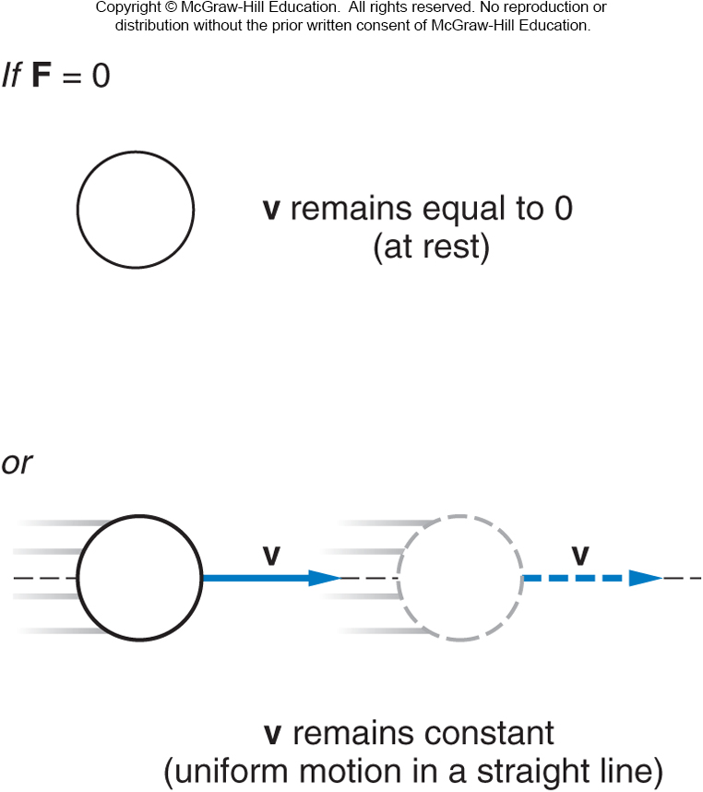
Newton’s First Law of Motion
An object remains at rest, or in uniform motion in a straight line, unless it is compelled to change by an externally imposed force.

Slide 47
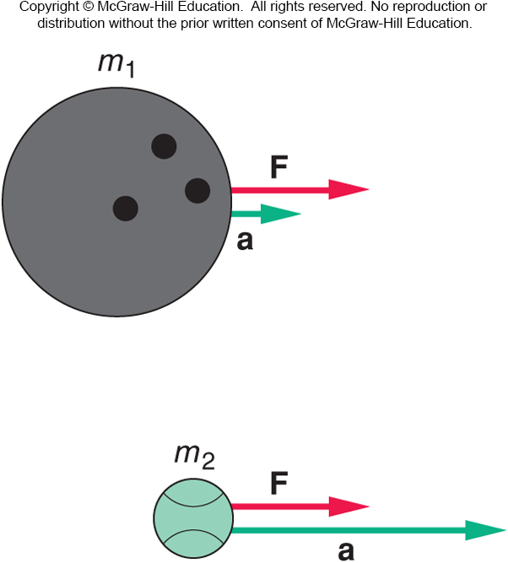
Newton’s Second Law of Motion
The acceleration of an object is directly proportional to the magnitude of the imposed force and inversely proportional to the mass of the object.
The acceleration is the same direction as that of the imposed force.

Slide 48
Newton’s Second Law of Motion
Note that a force is proportional to an object’s acceleration, not its velocity.
We need some precise definitions of some commonly used terms:
This resistance to a change in motion is called inertia.
The mass of an object is a quantity that tells us how much resistance (inertia) the object has to a change in its motion.

Slide 49
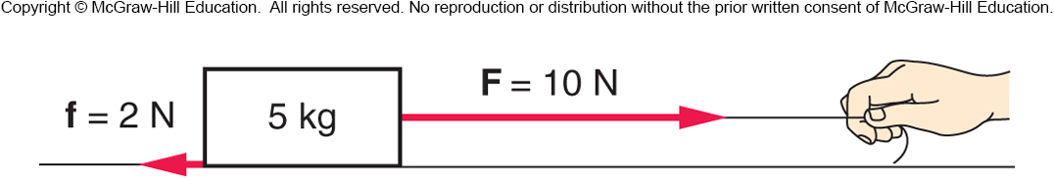
It is the total force or net force that determines an object’s acceleration.
If there is more than one vector acting on an object, the forces are added together as vectors, taking into account their directions.

Slide 50
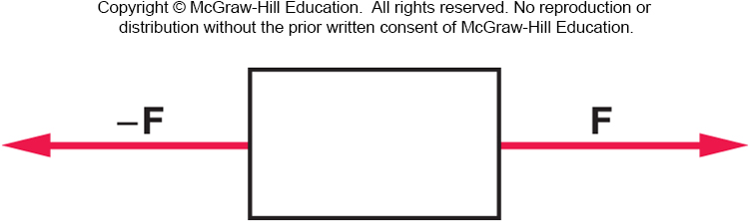
Two equal-magnitude horizontal forces act on a box. Is the object accelerated horizontally?
Since the two forces are equal in size, and are in opposite directions, they cancel each other out and there is no acceleration.
Yes.
No.
You can’t tell from
this diagram.

Slide 51
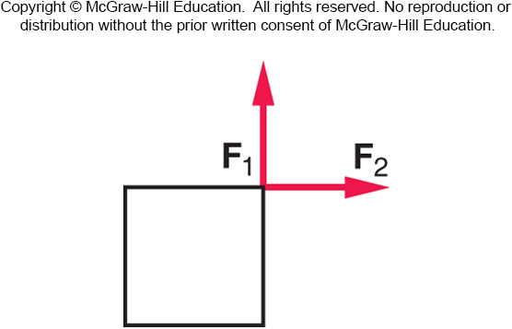
Two equal forces act on an object in the directions shown. If these are the only forces involved, will the object be accelerated?
Yes.
No.
It is impossible to determine
from this figure.
The vector sum of the two forces results in a force directed toward the upper right corner. The object will be accelerated toward the upper right corner.

Slide 52
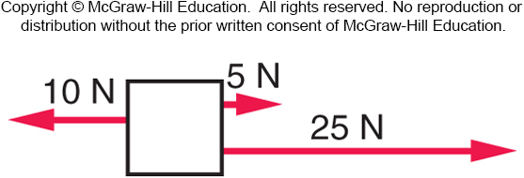
A 4-kg block is acted on by three horizontal forces. What is the net horizontal force acting on the block?
10 N
20 N
25 N
30 N
40 N
The net horizontal force is:
5 N + 25 N - 10 N = 20 N directed to the right.

Slide 53
Mass and Weight
What exactly is mass?
Is there a difference between mass and weight?
If something is weightless in space, does it still have mass?

Slide 54
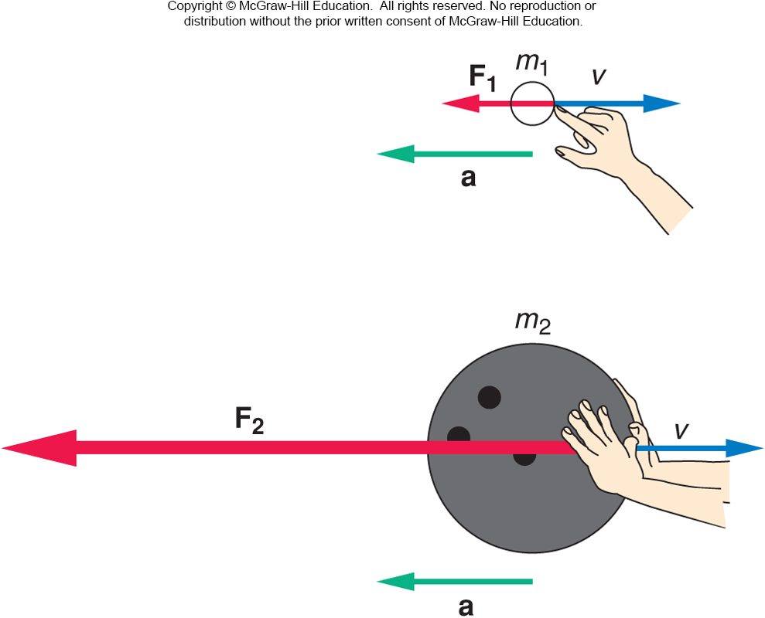
Mass, Weight, and Inertia
A much larger force is required to produce the same acceleration for the larger mass.
Inertia is an object’s resistance to a change in its motion.
Mass is a measure of an object’s inertia.
The units of mass are kilograms (kg).

Slide 55
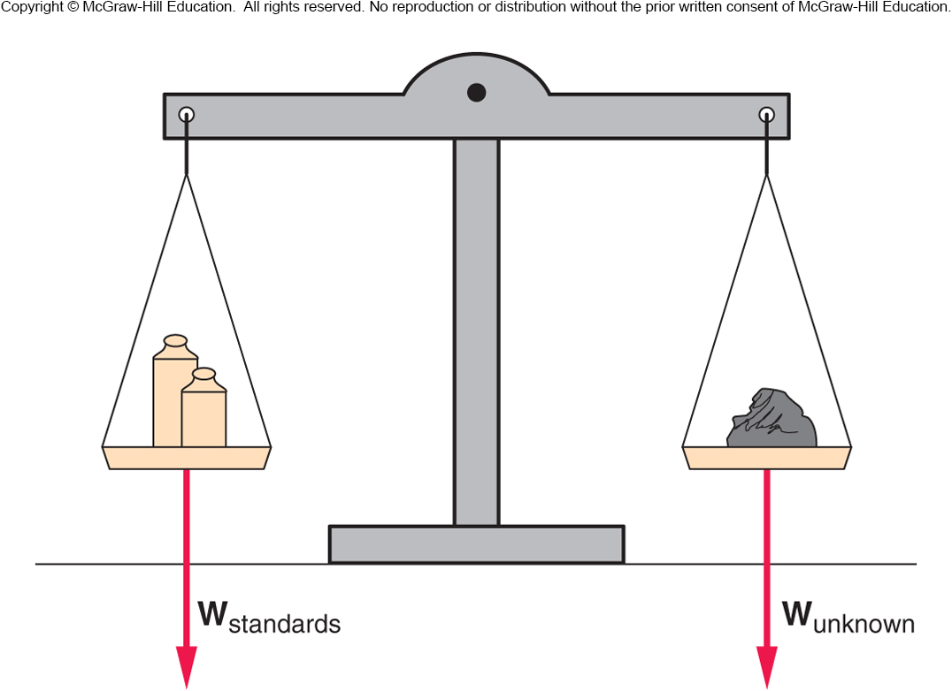
Mass, Weight, and Inertia
An object’s weight is the gravitational force acting on the object.
Weight is a force, measured in units of newtons (N).
In the absence of gravity, an object has no weight but still has the same mass.

Slide 56
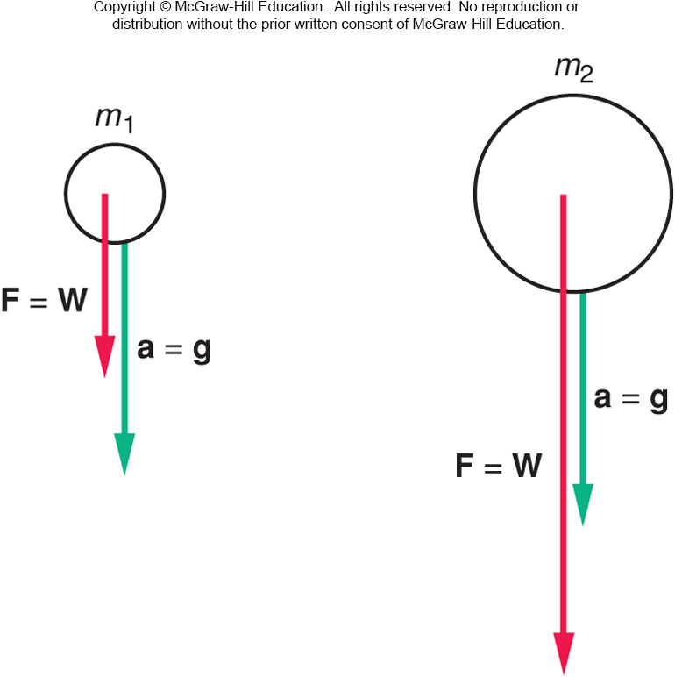
Mass, Weight, and Inertia
Objects of different mass experience the same gravitational acceleration on Earth: g = 9.8 m/s²
By Newton’s 2nd Law, F = ma, the weight is W = mg.
Different gravitational forces (weights) act on falling objects of different masses, but the objects have the same acceleration.

Slide 57
Newton’s Third Law
Where do forces come from?
If we push on an object like a chair, does the chair also push back on us?
If objects do push back, who experiences the greater push, us or the chair?
Does our answer change if we are pushing against a wall?
How does Newton’s third law of motion help us to define force, and how is it applied?

Slide 58
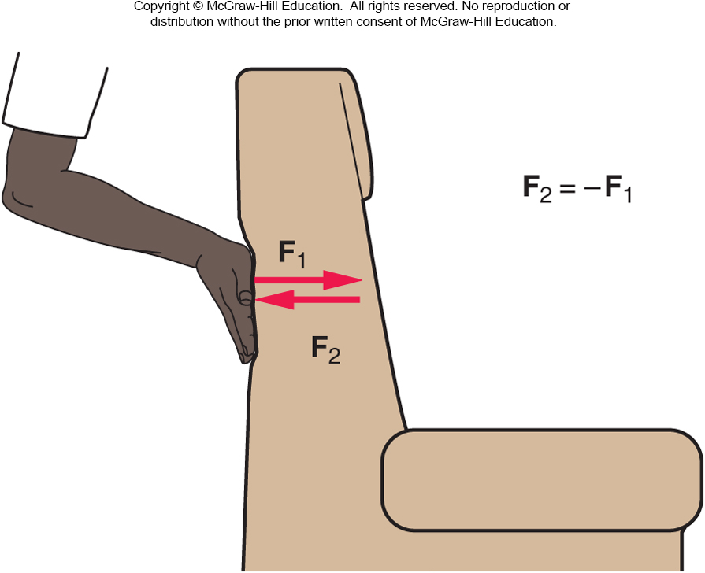
Newton’s Third Law
(“action/reaction”)
For every action (force),
there is an equal but opposite reaction
(force).

Slide 59
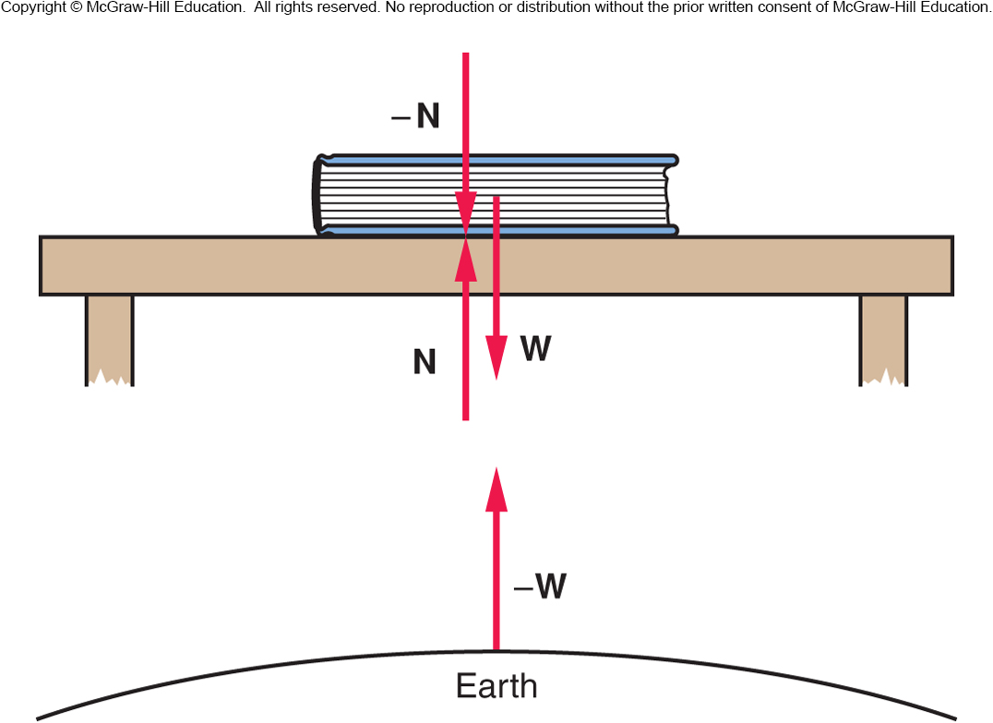
It is important to identify the forces acting on an object.
The forces acting on the book are W (gravitational force from Earth) and N (normal force from table).
Normal force refers to the perpendicular force a surface exerts on an object.

Slide 60
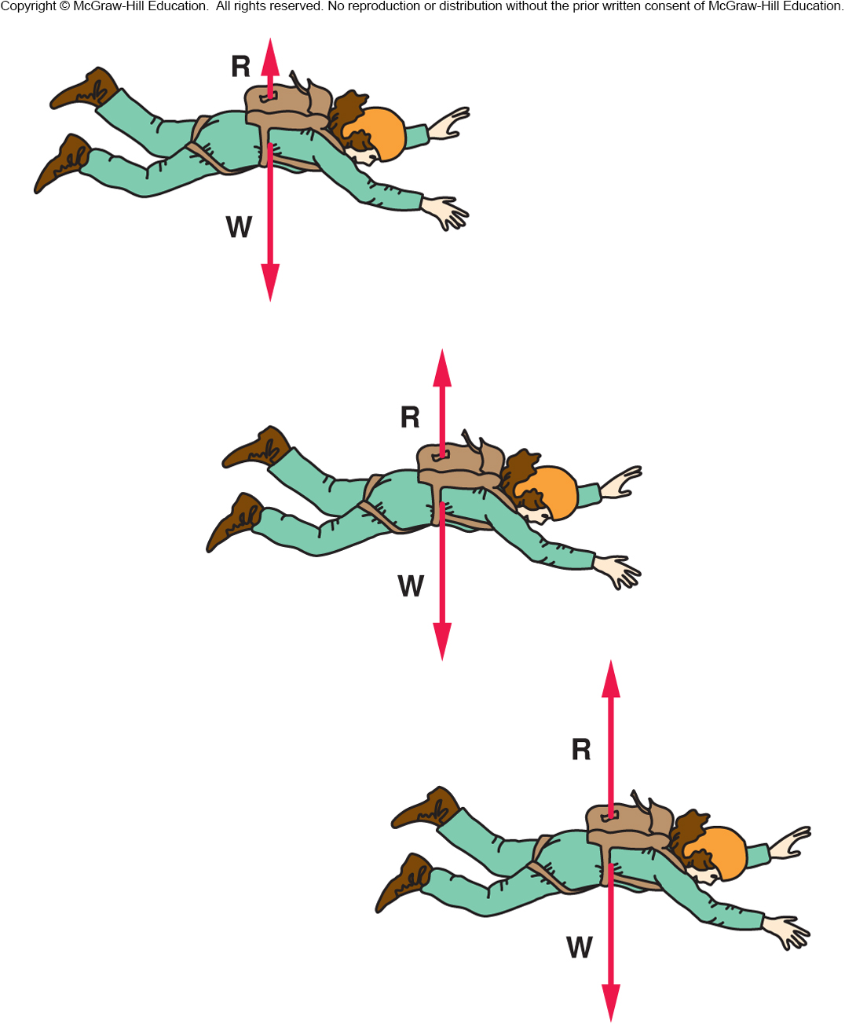
Does a sky diver continue to accelerate?
Air resistance R is a force directed upward, that opposes the gravitational force W
R increases as the sky diver’s velocity increases
When R has increased to the magnitude of W, the net force is zero so the acceleration is zero
The velocity is then at its maximum value, the terminal velocity

